Slide 1
10.20

Slide 2
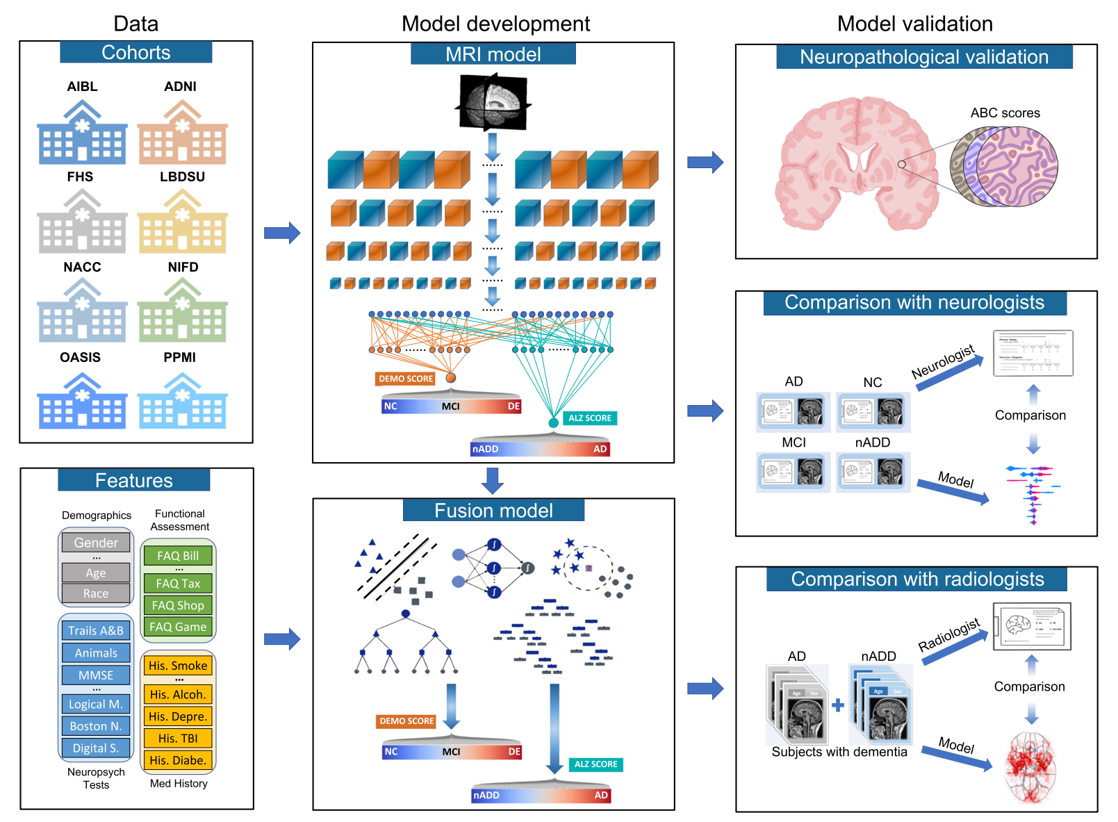

Slide 3
数据库申请进度
AIBL: 未收到回复
ADNI: 已汇总
FHS: 拒绝
LBDSU: in-house data
NACC: 申请中，目前申请人数多，需要等
NIFD:已汇总
OASIS:已汇总
PPMI:已汇总

Slide 4
NIFD

Slide 5
数据介绍
NIFD是frontotemporal lobar degeneration neuroimaging initiative（FTLDNI，AG032306）的昵称，该倡议由NIA和NINDS资助，用于表征FTLD的纵向临床和图像变化。NIFD和4-Repeat Taopathy Neuroimaging Initiative（4RTNI）的图像和临床方法相同，也可从LONI下载。NIFD的控制与4RTNI收集的控制相同。
Image包含以下等信息：Subject, Research Group, Sex, Scan Date, Age, Modality, Series, Description, Weighting, Slice Thickness, Acquisition Plane
Clinical Data包含以下等信息：LONI_ID, DX, SITE, CLINICAL_LINKDATE, VISIT_NUMBER, DOB, GENDER, EDUCATION, RACE, CDR_DCDATE, CDR_LANG, CDR_BEHAV, CDR_TOT, CDR_BOX_SCORE, MMSE_DCDATE, MMSE_TOT
MRI: 11588 image fMRI: 3394 image PET: 679 image DTI: 4269 image

Slide 6
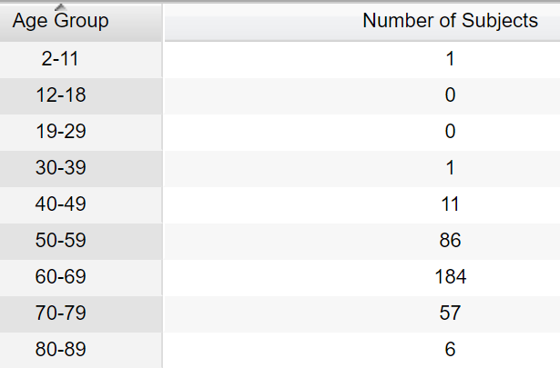
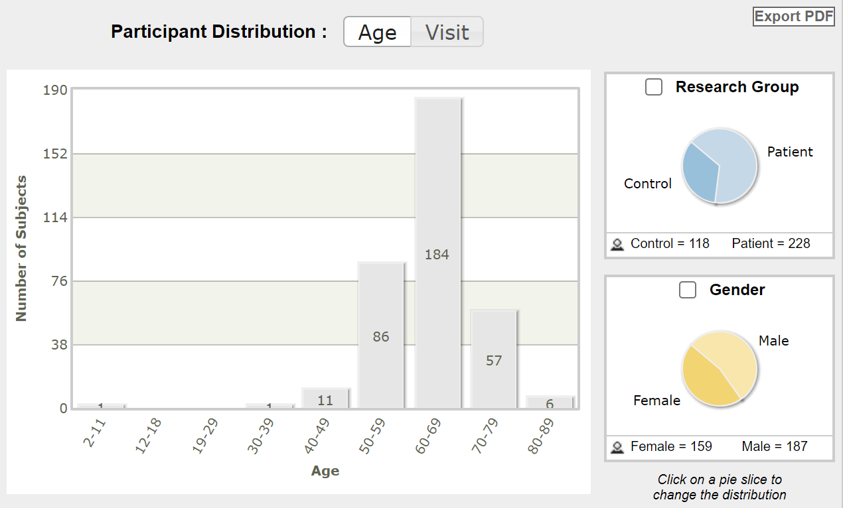
Participants Distribution:Age

Slide 7
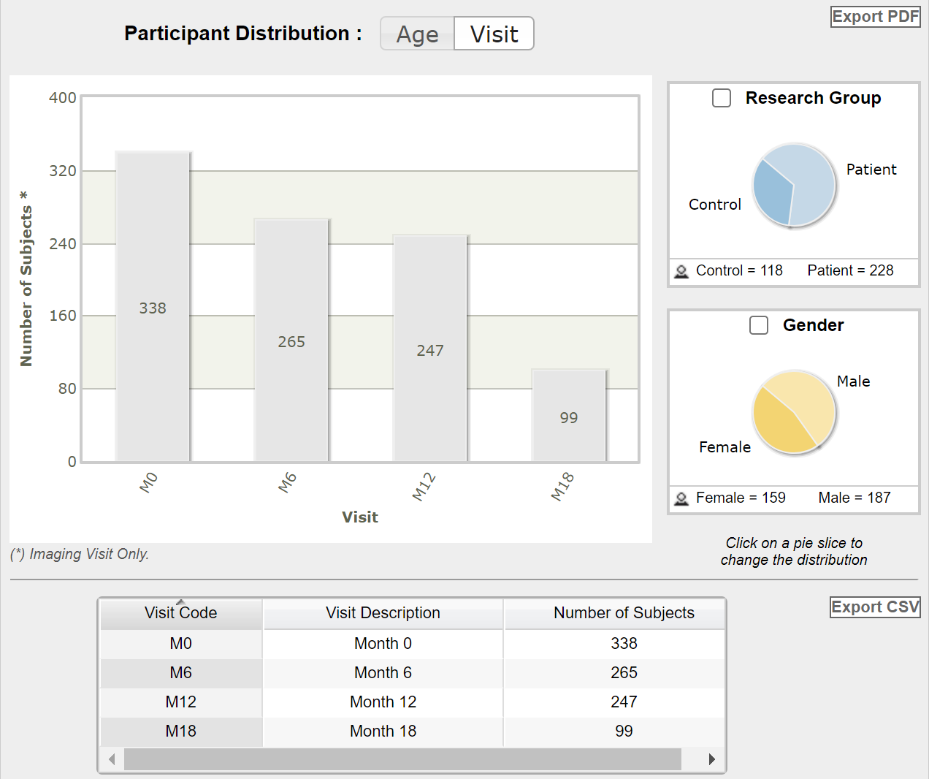
Participants Distribution:Visit
参与者根据他们在研究期间的不同访问次数进行分组
Visit code:标识参与者在研究期间进行的不同访问或评估时间点的一种编码系统
通过visit code, 研究人员可以准确地识别和对应不同的访问时间点，比较不同时间点的数据，并观察疾病的进展或治疗效果的变化

Slide 8
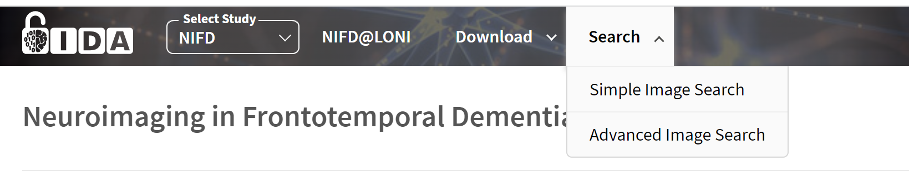
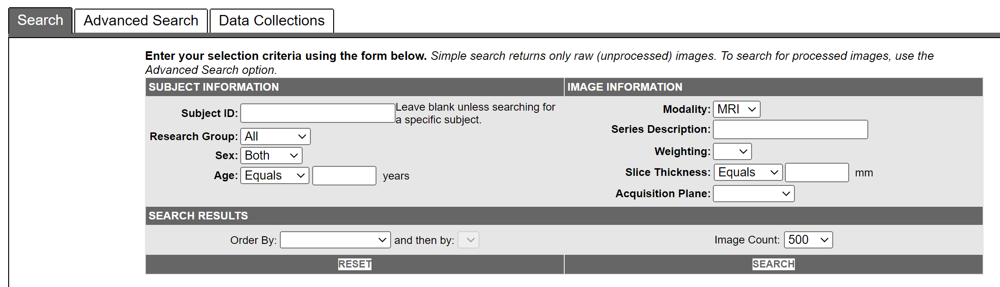
Image data
可在Search中直接进行搜索查找数据。

Slide 9
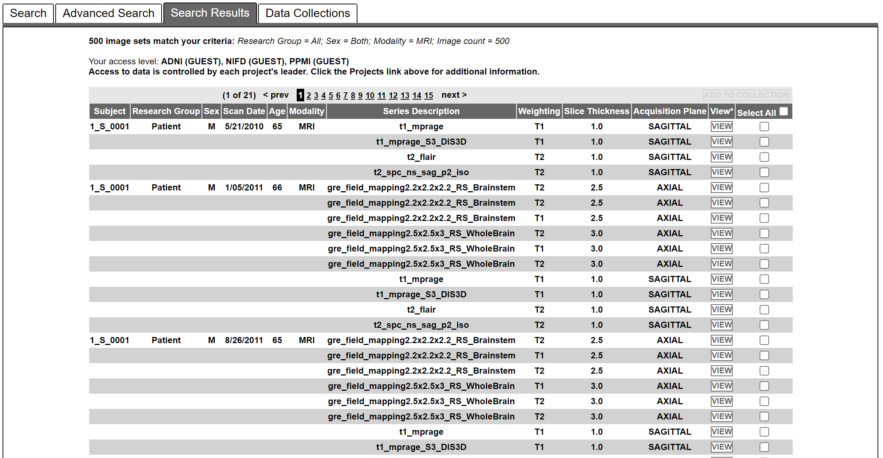
以 Modality = MRI 为例进行查找：

Slide 10
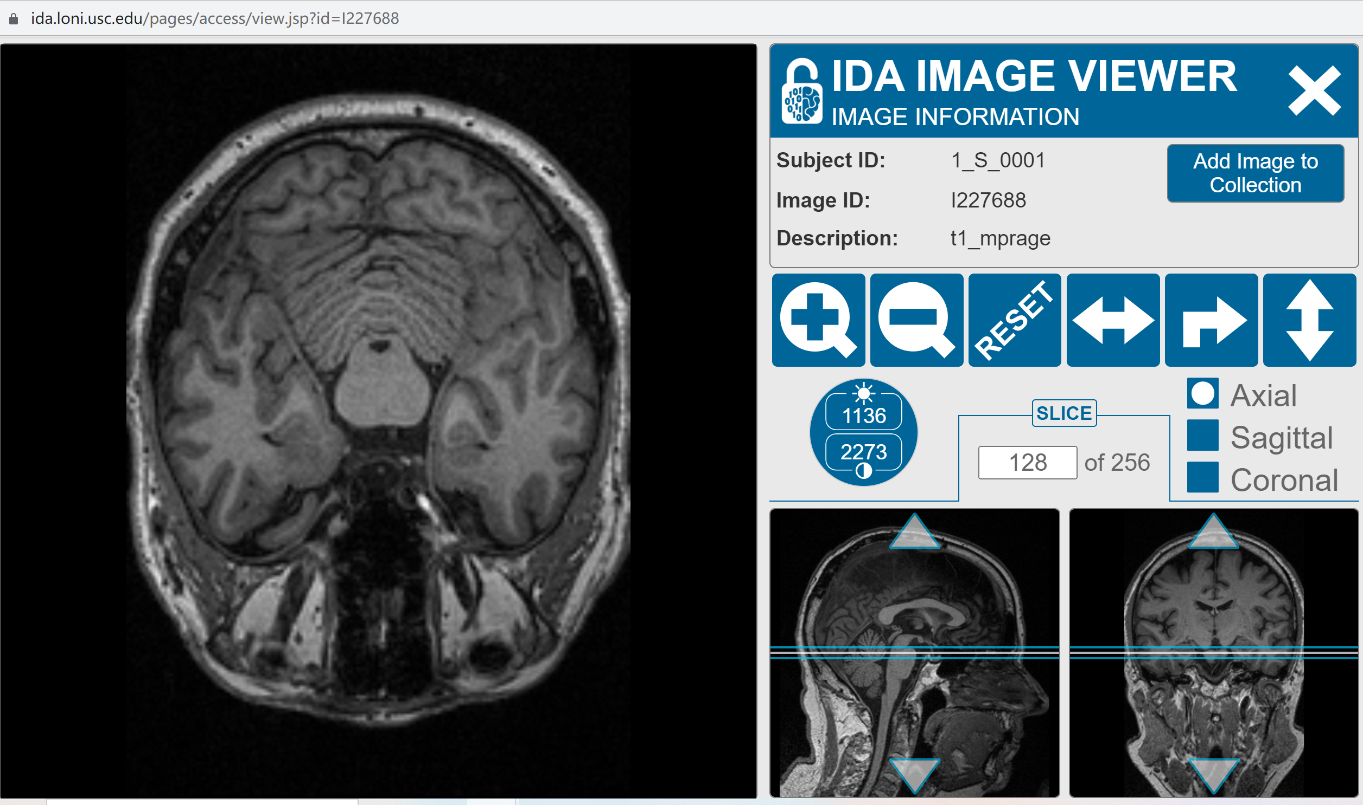
可点击view查看image

Slide 11
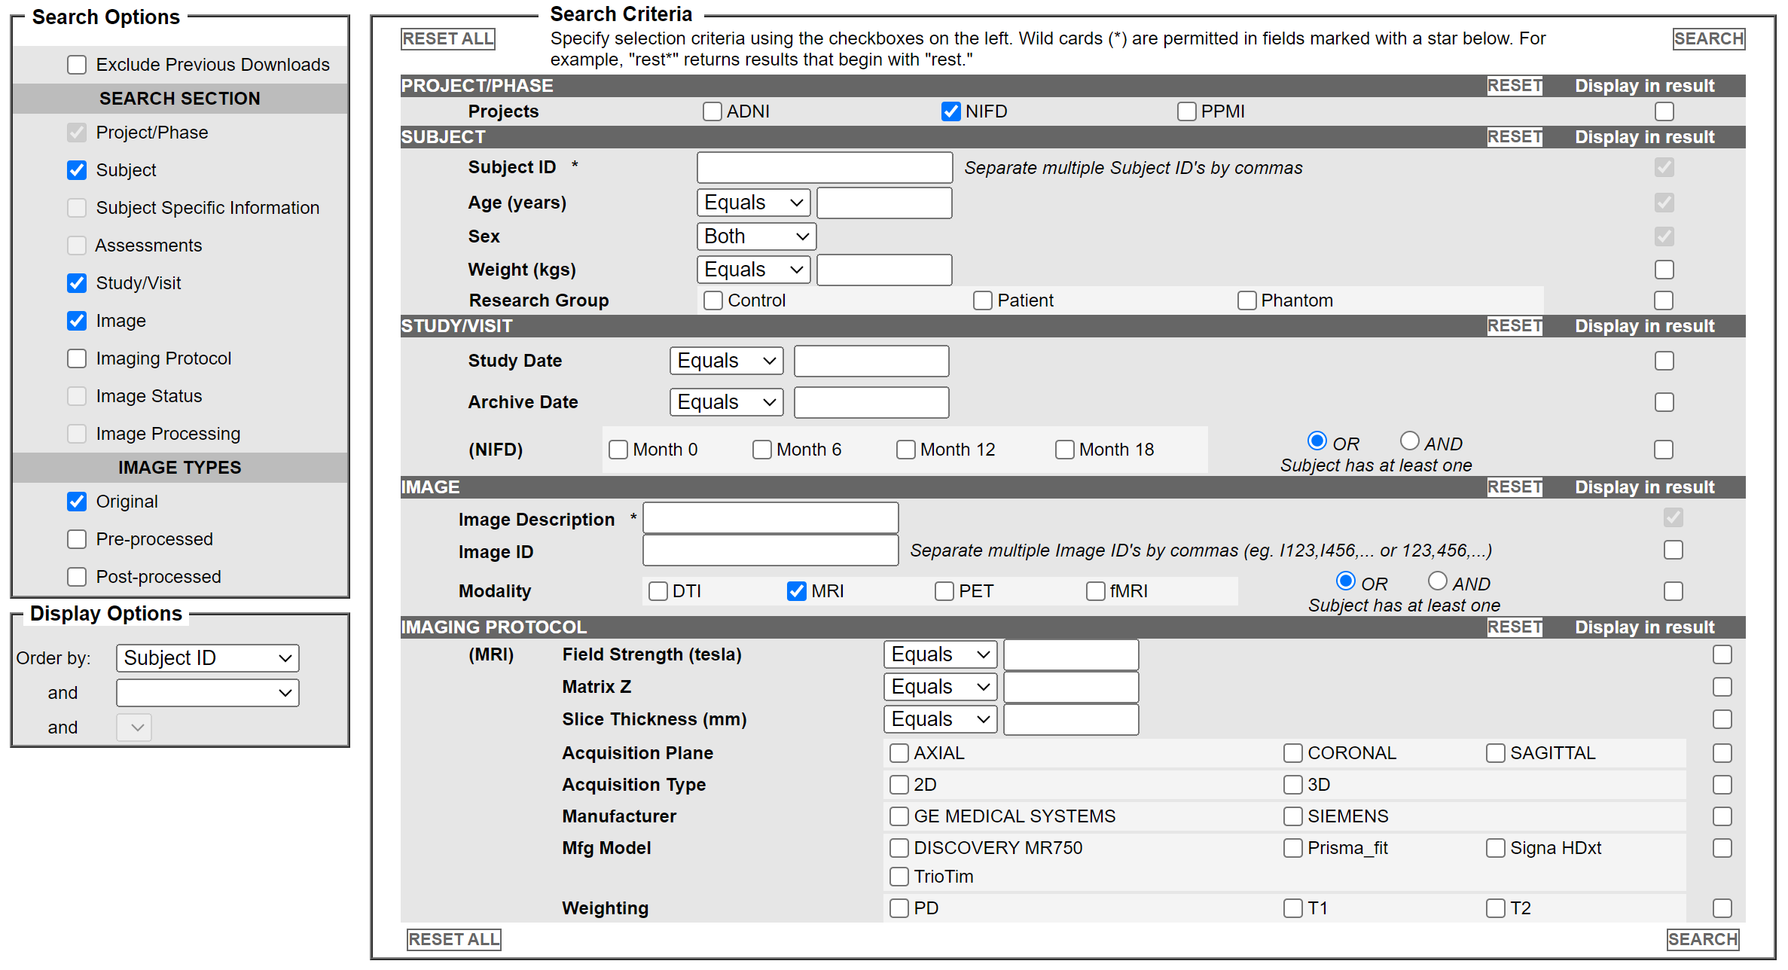
Advanced search
可对processed images进行搜索，功能更多

Slide 12
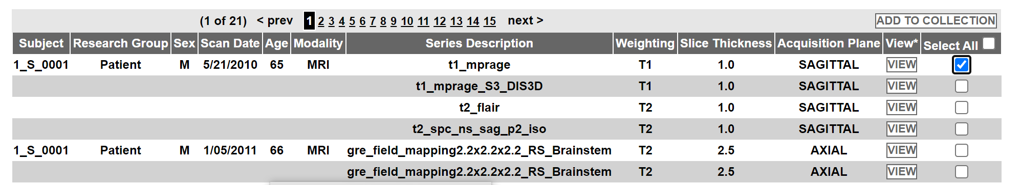
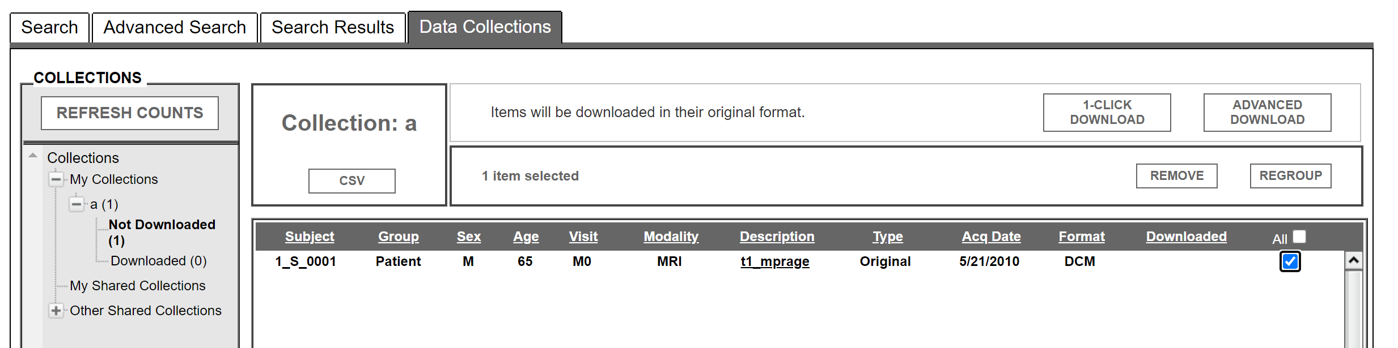
image下载
在search中进行搜索，选定subject并将其add to collection
之后在data collections 中进行下载

Slide 13
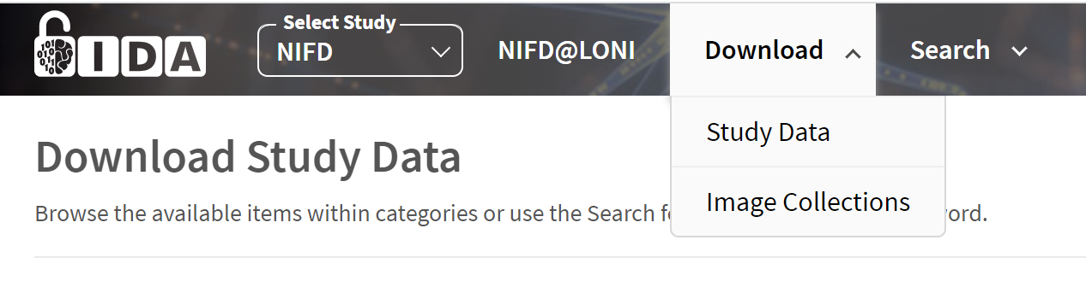
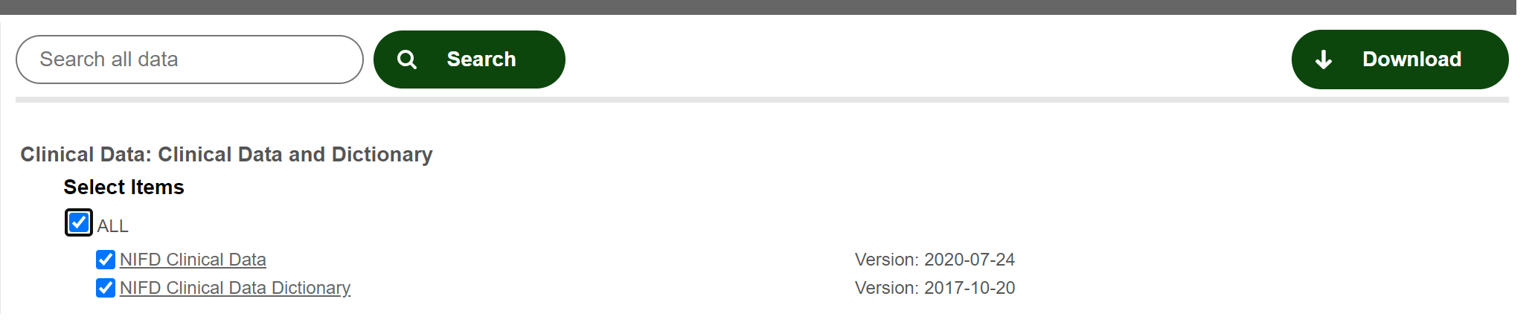
Clinical Data下载
在download中选择study data，并进行下载

Slide 14
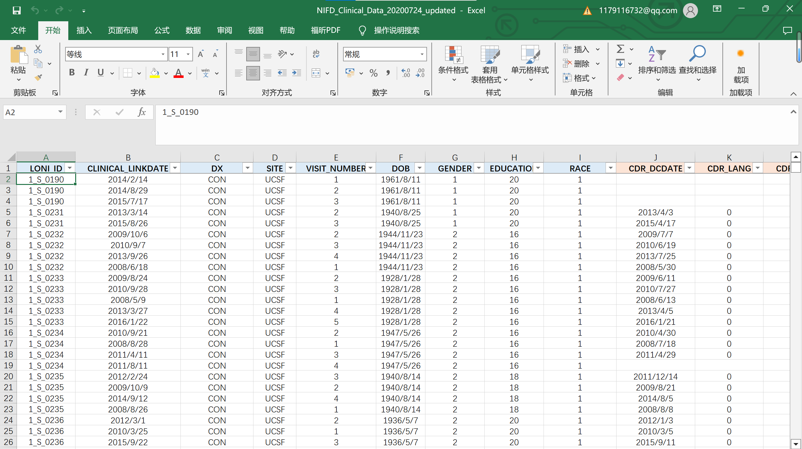
NIFD_Clinical_Data_20200724_updated

Slide 15
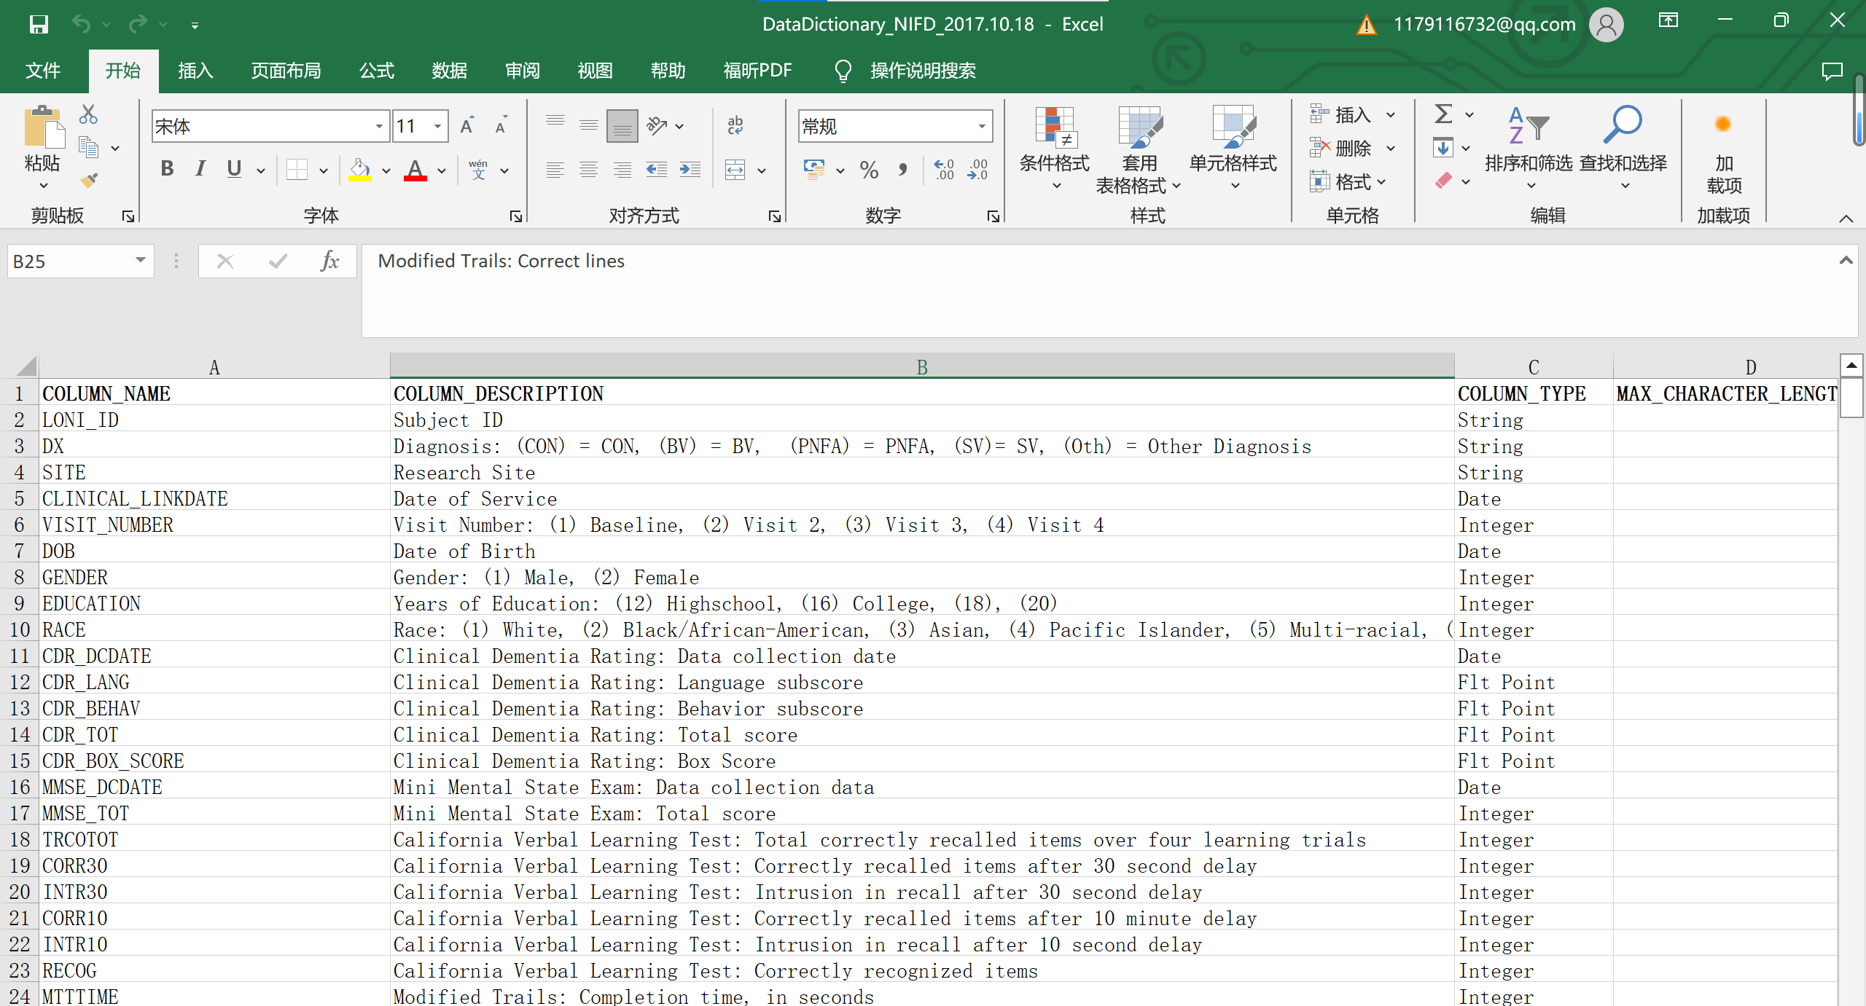
DataDictionary_NIFD_2017.10.18

Slide 16
OASIS

Slide 17
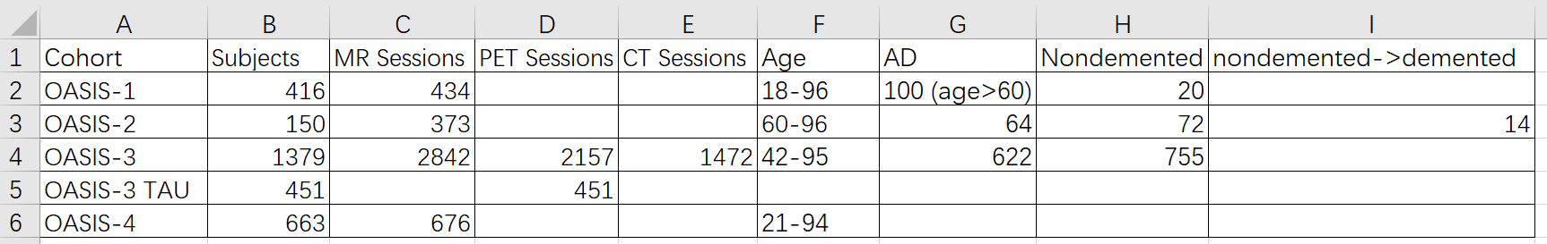
开放获取系列成像研究（OASIS）是一个旨在向科学界免费提供大脑神经成像数据集的项目。
OASIS Brains Datasets
OASIS-1: Cross-sectional MRI Data in Young, Middle Aged, Nondemented and Demented Older Adults
OASIS-2: Longitudinal MRI Data in Nondemented and Demented Older Adults
OASIS-3: Longitudinal Multimodal Neuroimaging, Clinical, and Cognitive Dataset for Normal Aging and Alzheimer’s Disease
OASIS-3 TAU: OASIS-3 Flortaucipir F18 (AV1451) PET
OASIS-4: Clinical Cohort

Slide 18
OASIS-1

Slide 19
OASIS-1: Cross-sectional MRI Data in Young, Middle Aged, Nondemented and Demented Older Adults年轻、中年、非痴呆和痴呆老年人的横断面MRI数据
Adults Subjects: 416
MR Sessions: 434
这一组包括416名年龄在18至96岁之间的受试者。对于每个受试者，包括在单次扫描中获得的3或4次单独的T1加权MRI扫描。受试者都是右撇子，包括男性和女性。在纳入的60岁以上受试者中，有100人被临床诊断患有非常轻中度阿尔茨海默病（AD）。此外，还包括一个可靠性数据集，其中包含 20 名没有痴呆症的受试者，这些受试者在初次治疗后 90 天内的后续访问中进行了成像。

Slide 20
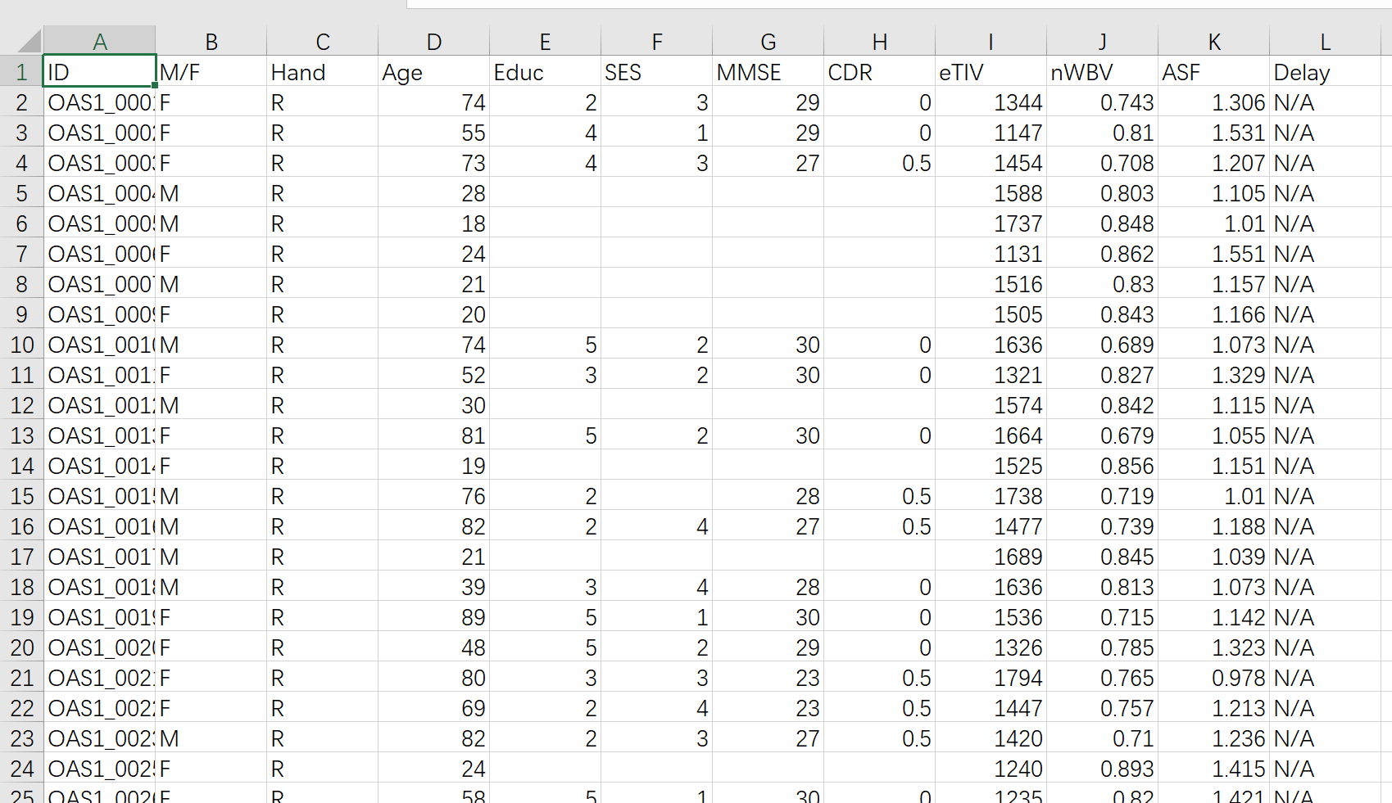

Slide 21
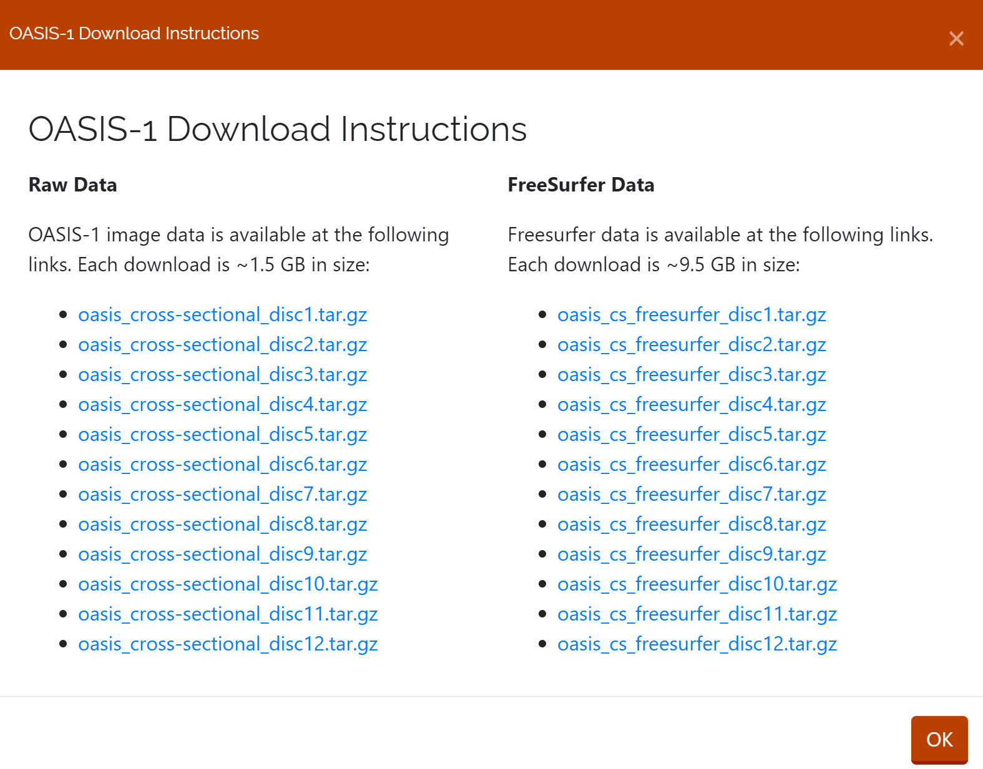

Slide 22
OASIS-2

Slide 23
OASIS-2: Longitudinal MRI Data in Nondemented and Demented Older Adults
Subjects: 150
MR Sessions: 373
Summary: This set consists of a longitudinal collection of 150 subjects aged 60 to 96. Each subject was scanned on two or more visits, separated by at least one year for a total of 373 imaging sessions. For each subject, 3 or 4 individual T1-weighted MRI scans obtained in single scan sessions are included. The subjects are all right-handed and include both men and women. 72 of the subjects were characterized as nondemented throughout the study. 64 of the included subjects were characterized as demented at the time of their initial visits and remained so for subsequent scans, including 51 individuals with mild to moderate Alzheimer’s disease. Another 14 subjects were characterized as nondemented at the time of their initial visit and were subsequently characterized as demented at a later visit.

Slide 24
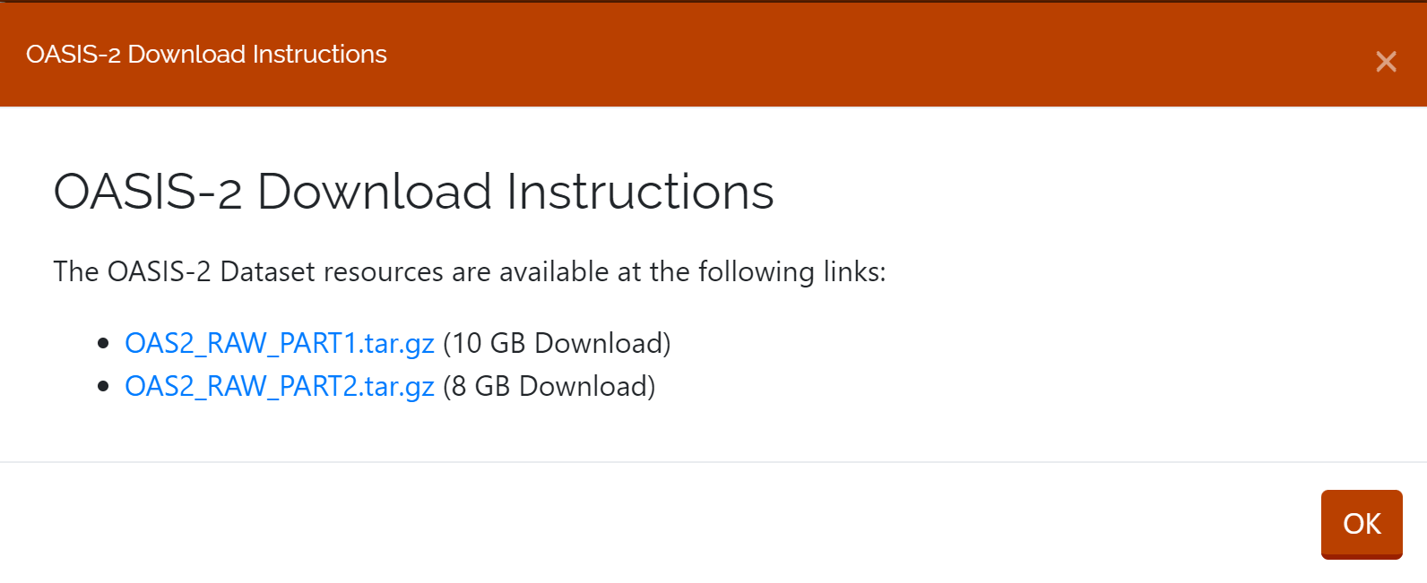

Slide 25
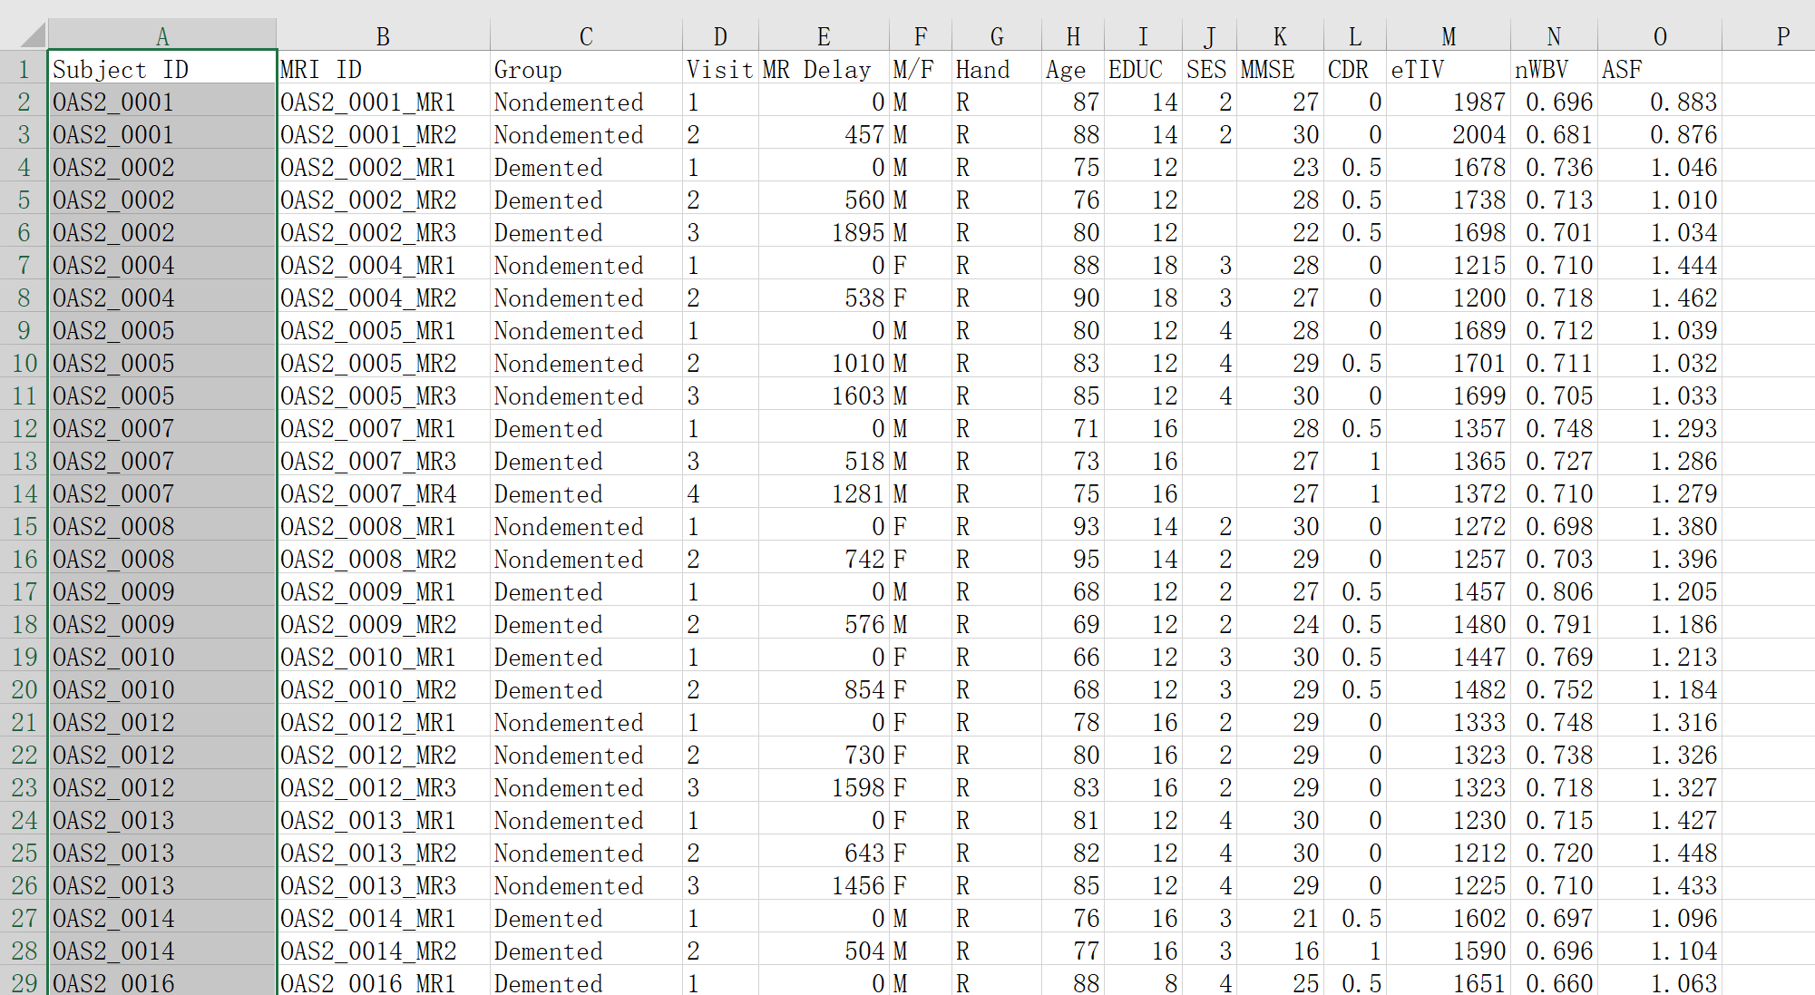

Slide 26
OASIS-3

Slide 27
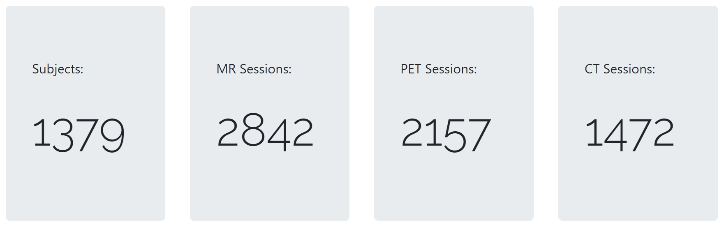
OASIS-3: Longitudinal Multimodal Neuroimaging, Clinical, and Cognitive Dataset for Normal Aging and Alzheimer’s Disease

Slide 28
OASIS-4

Slide 29
OASIS-4: Clinical Cohort
Subjects: 663
MR Sessions: 676
This set consists of a collection of 663 subjects aged 21 to 94. This clinical cohort was evaluated for memory disorders and dementia including clinical, csf, neurospychometric, and neuroimaging assessments. This is a unique dataset and not an update to the OASIS-3 Longitudinal Multimodal Neuroimaging dataset.

Slide 30
PPMI

